Slide 1

Module 1
Regression Basics
Notes:
Guidelines
Use section headers to chunk content in your presentation.
Use the same style of section header throughout your presentation.
Keep your title to no more than 2 lines.

Slide 2
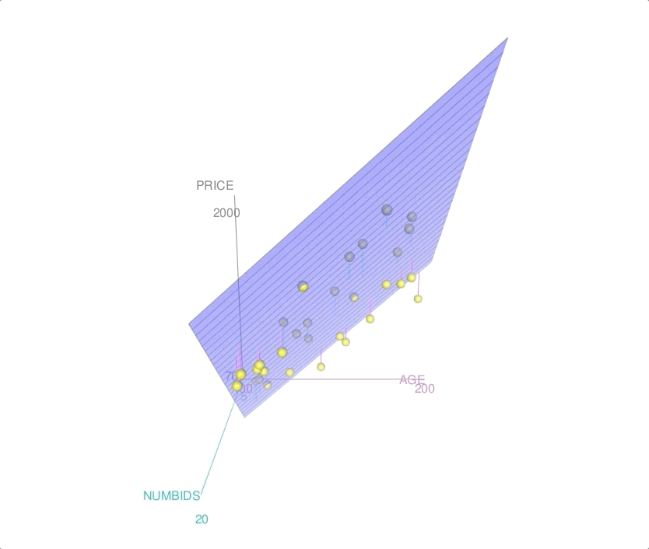
Introduction to MLR
Notes:
Guidelines
Use a title slide at the beginning of your presentation. There are 9 variations of title slides to choose from.
If you will have a series of slideshows, we recommend using the same style of title slide for each presentation.
Keep your title to no more than 2 lines.
Do not change the font style or font size of the title or subtitle.

Slide 3
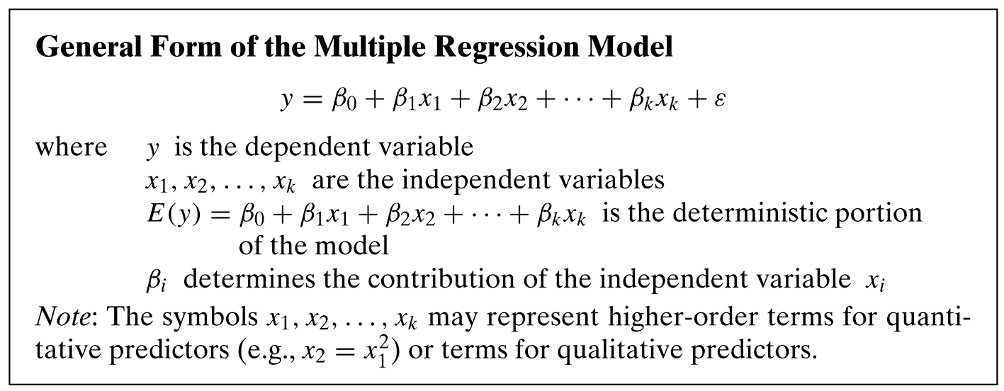
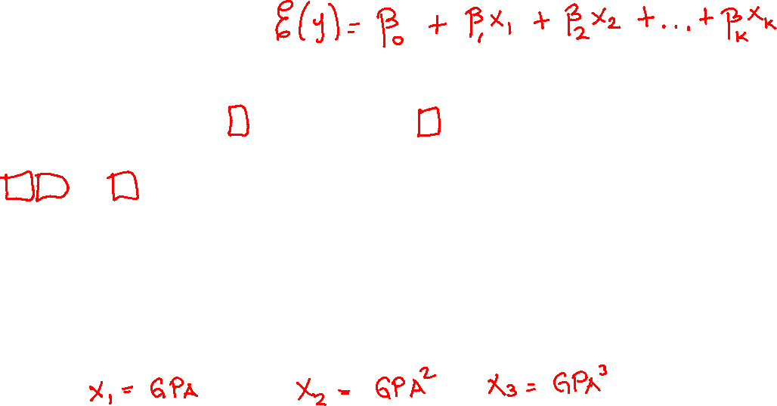
Population Model

Slide 4
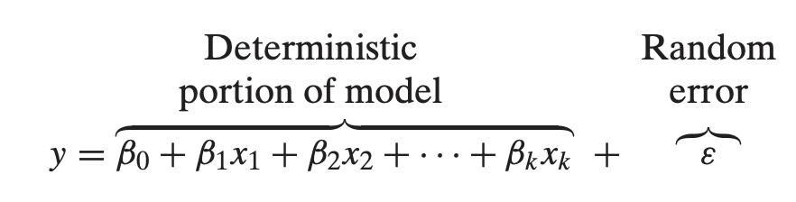
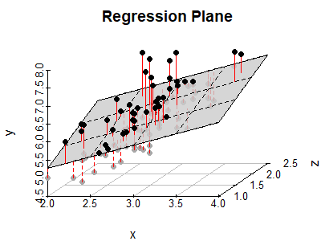
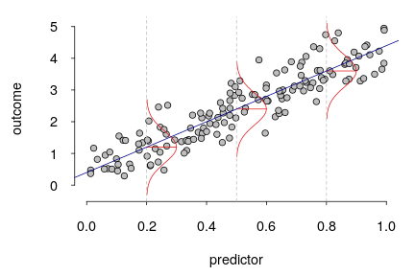
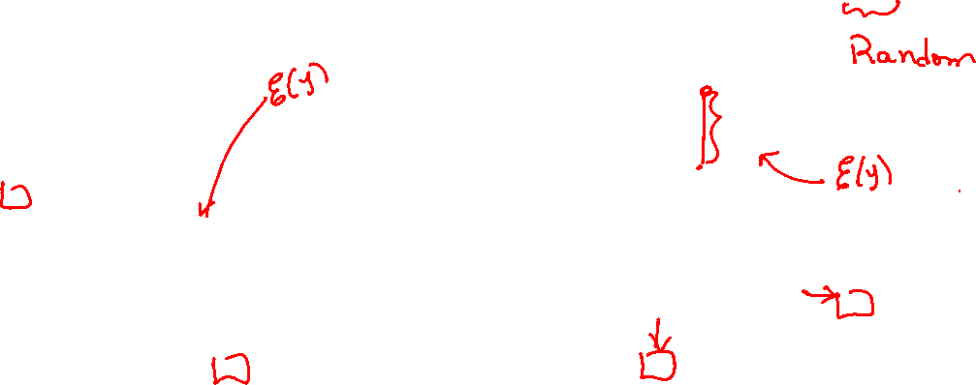
Population Model
1 predictor
2 predictors
y
y
x₂
x
x₁

Slide 5
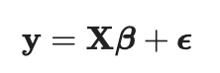
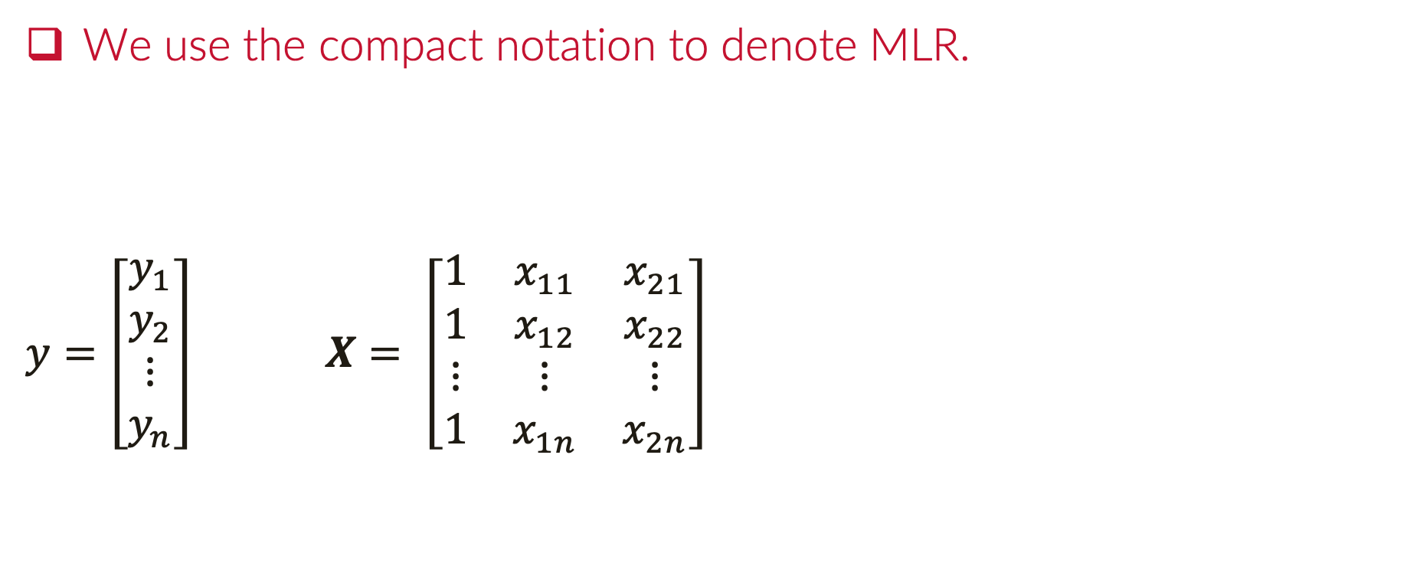
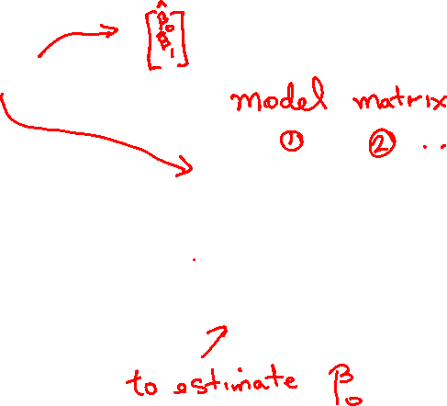
Matrix Formulation of MLR
We use the compact notation to denote MLR.
$y=\left[\begin{matrix}y_{1} \\ y_{2} \\ ⋮ \\ y_{n}\end{matrix}\right]$ $X= \left[\begin{matrix}1 & x_{11} & x_{21} \\ 1 & x_{12} & x_{22} \\ ⋮ & ⋮ & ⋮ \\ 1 & x_{1n} & x_{2n}\end{matrix}\right]$

Slide 6
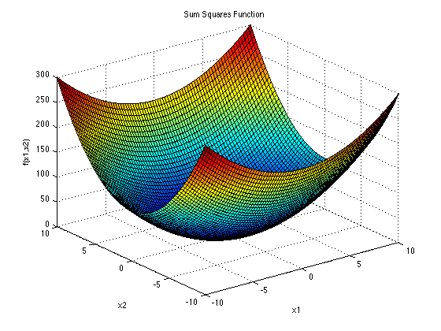
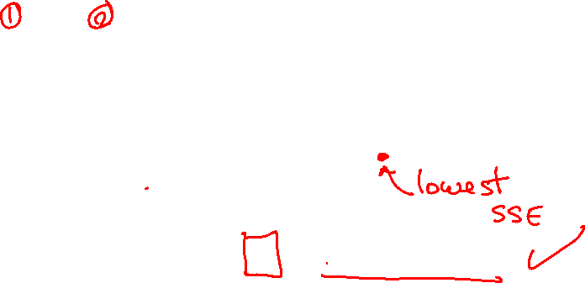
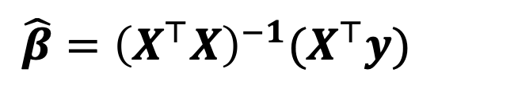
Matrix Formulation of MLR
We use the compact notation to denote MLR.
$y=\left[\begin{matrix}y_{1} \\ y_{2} \\ ⋮ \\ y_{n}\end{matrix}\right]$ $X= \left[\begin{matrix}1 & x_{11} & x_{21} \\ 1 & x_{12} & x_{22} \\ ⋮ & ⋮ & ⋮ \\ 1 & x_{1n} & x_{2n}\end{matrix}\right]$
$$\hat{β}={\left(X^{⊤}X\right)}^{−1}(X^{⊤}y)$$

Slide 7
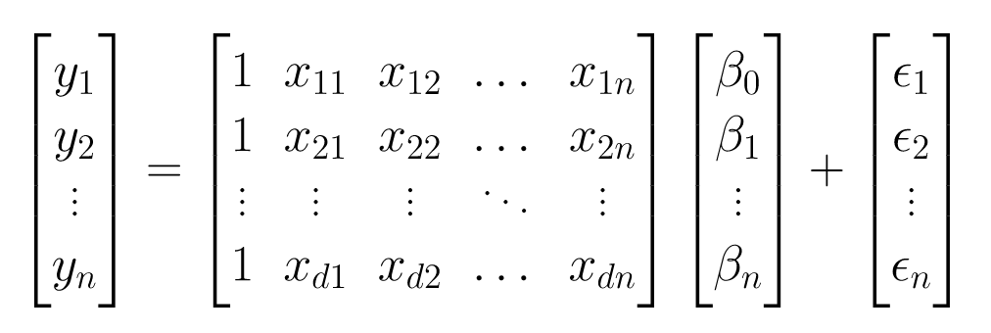
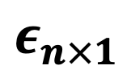
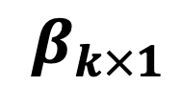
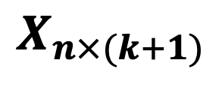
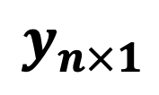
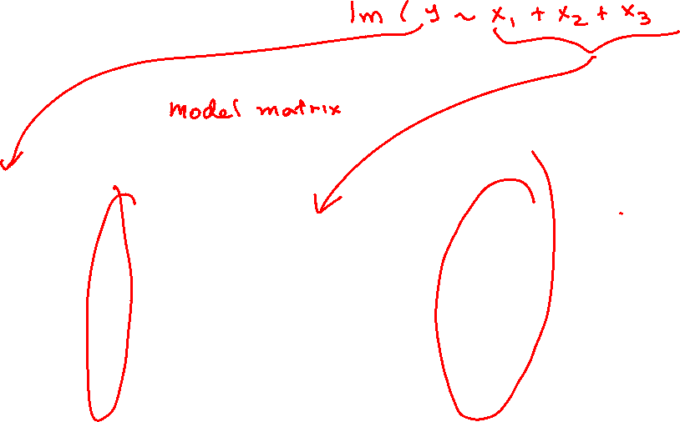
Matrix Formulation on MLR
The formulation does not change for higher dimensions
$$y_{n×1}$$
$$X_{n×(k+1)}$$
$$β_{k×1}$$
$$ε_{n×1}$$

Slide 8
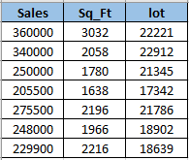
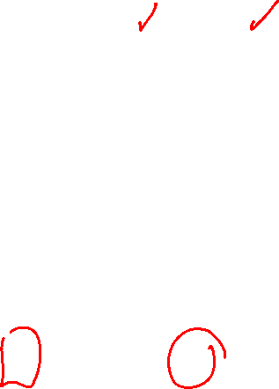

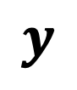
Example
Extracting the X Matrix (Design Matrix) and y vector
$$y$$
$$X$$

Slide 9
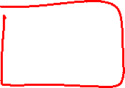
The X Matrix (Design Matrix)
In LR a column of 1s is added to the X Matrix to estimate the y-intercept
DESIGN MATRIX
Independent
(with no singularities)

Slide 10
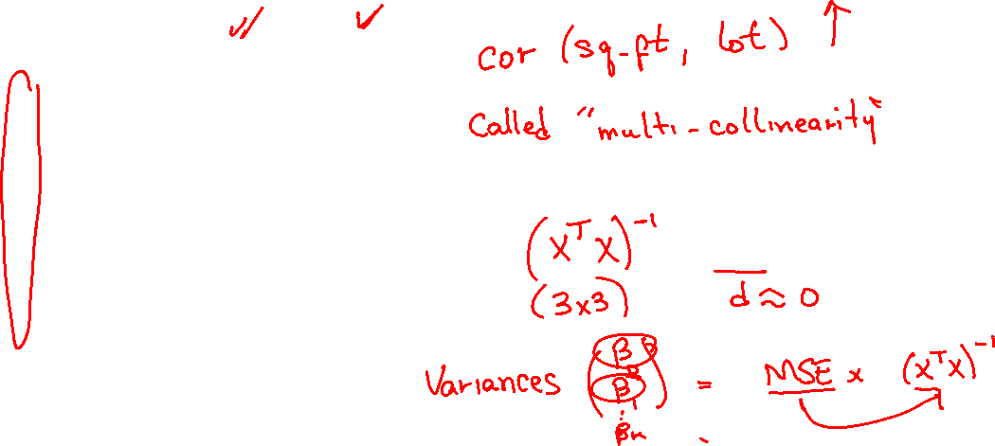
The X Matrix (Design Matrix)
In LR a column of 1s is added to the X Matrix to estimate the y-intercept
intercept
1
1
1
1
1
1
1
Independent
(with no singularities)

Slide 11
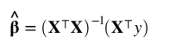
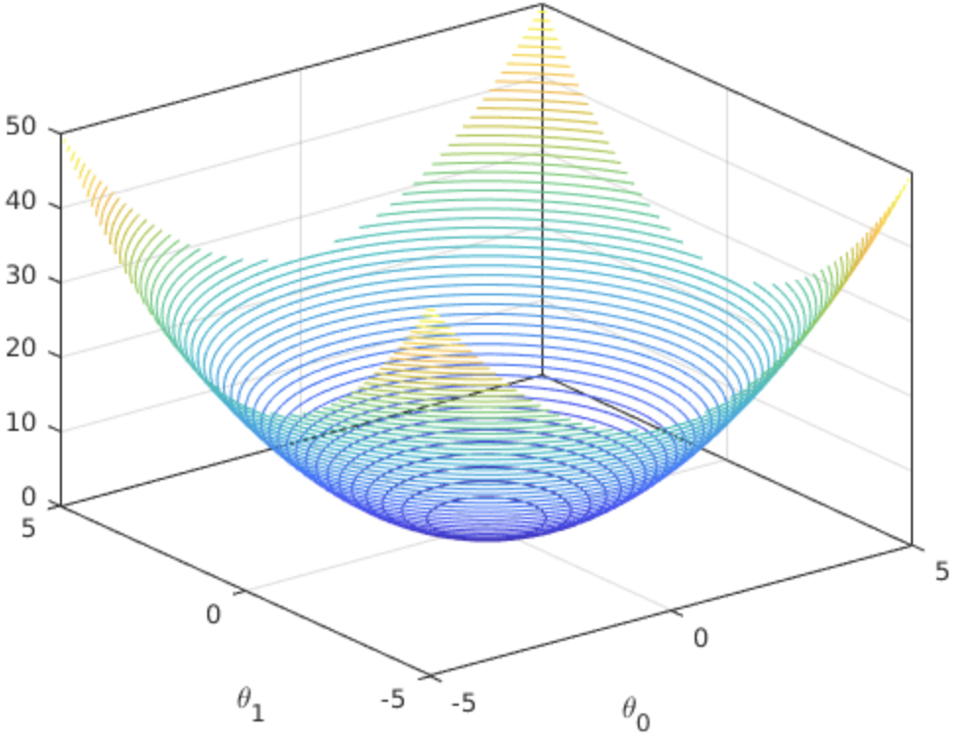
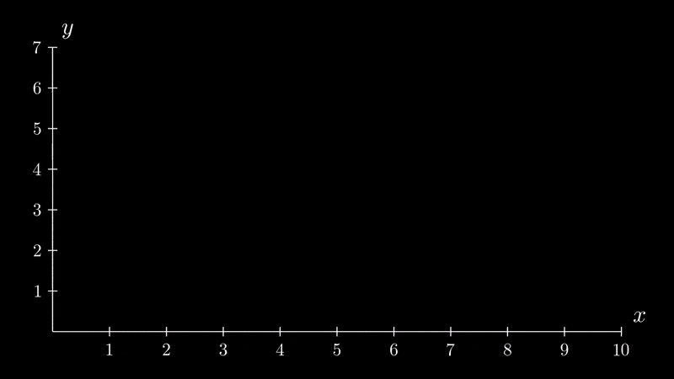
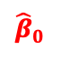

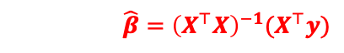
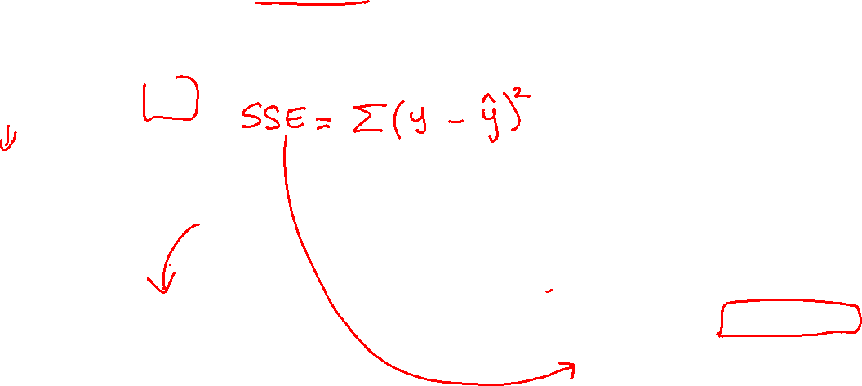
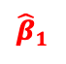
The Method of Least Squares
The least-squares estimates are obtained by selecting the estimates that minimize SSE.
$$SSE$$
$$\hat{β}={\left(X^{⊤}X\right)}^{−1}(X^{⊤}y)$$
$${\hat{β}}_{0}$$
$${\hat{β}}_{1}$$

Slide 12
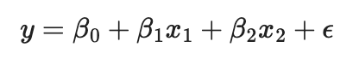
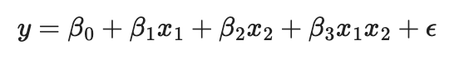
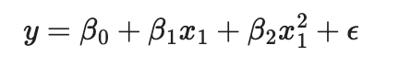
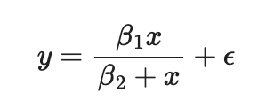
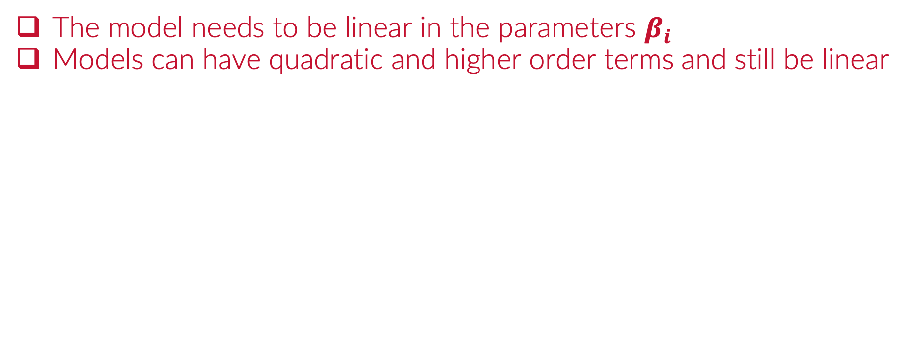
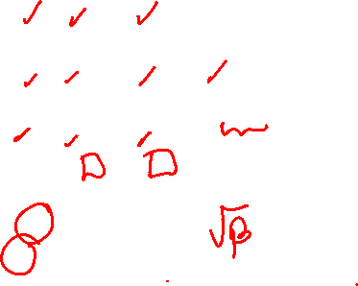
Linearity
The model needs to be linear in the parameters $β_{i}$
Models can have quadratic and higher order terms and still be linear
LINEAR IN THE PARAMETERS
✓
✓
✓
PARAMETERS
✘

Slide 13
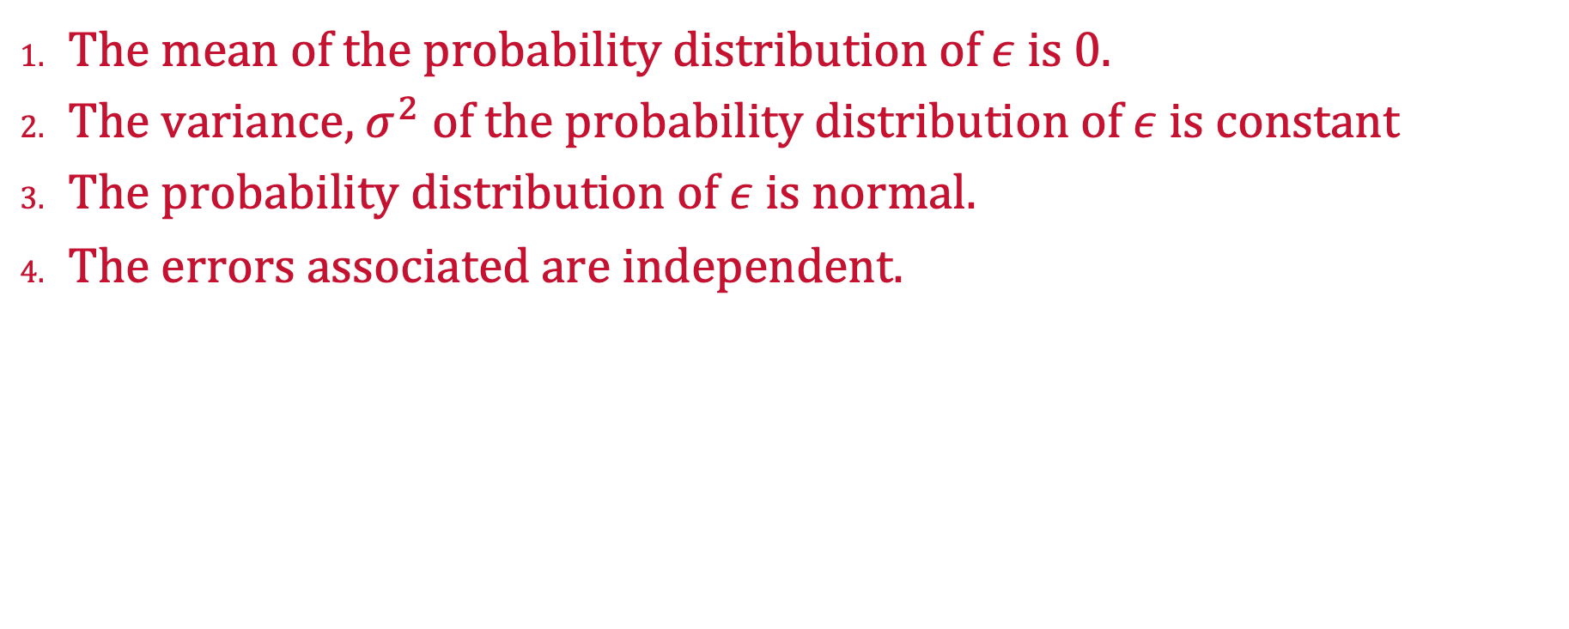
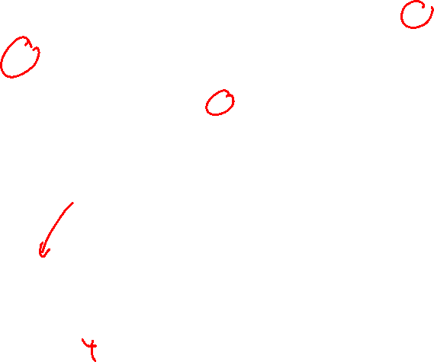
Assumptions for Inference in MLR
The mean of the probability distribution of $ε$ is 0.
The variance, $σ^{2}$ of the probability distribution of $ε$ is constant
The probability distribution of $ε$ is normal.
The errors associated are independent.

Slide 14
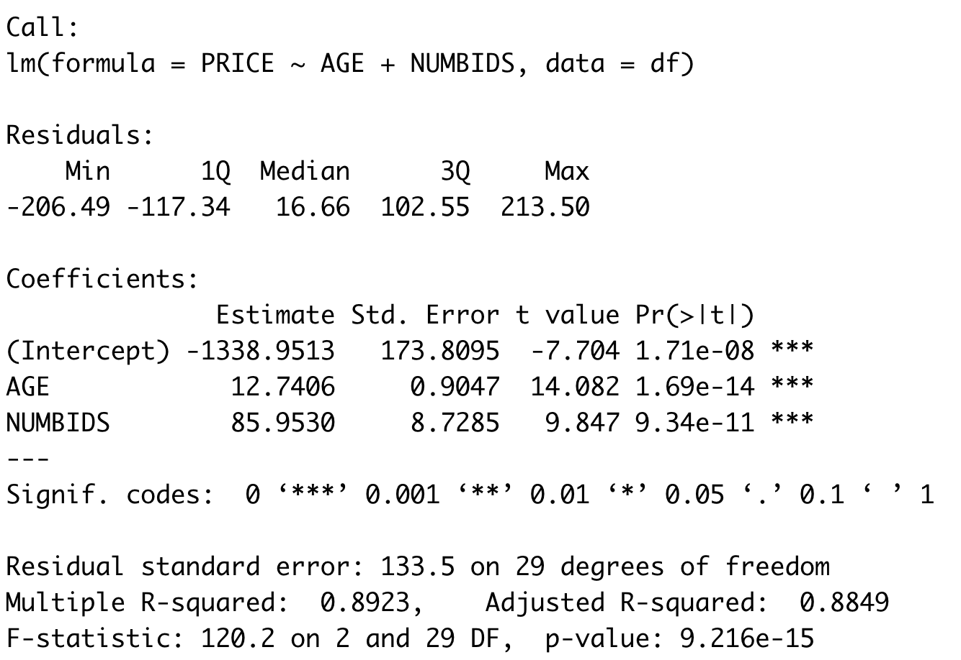
Fitting a MLR
Obtaining the estimates

Slide 15
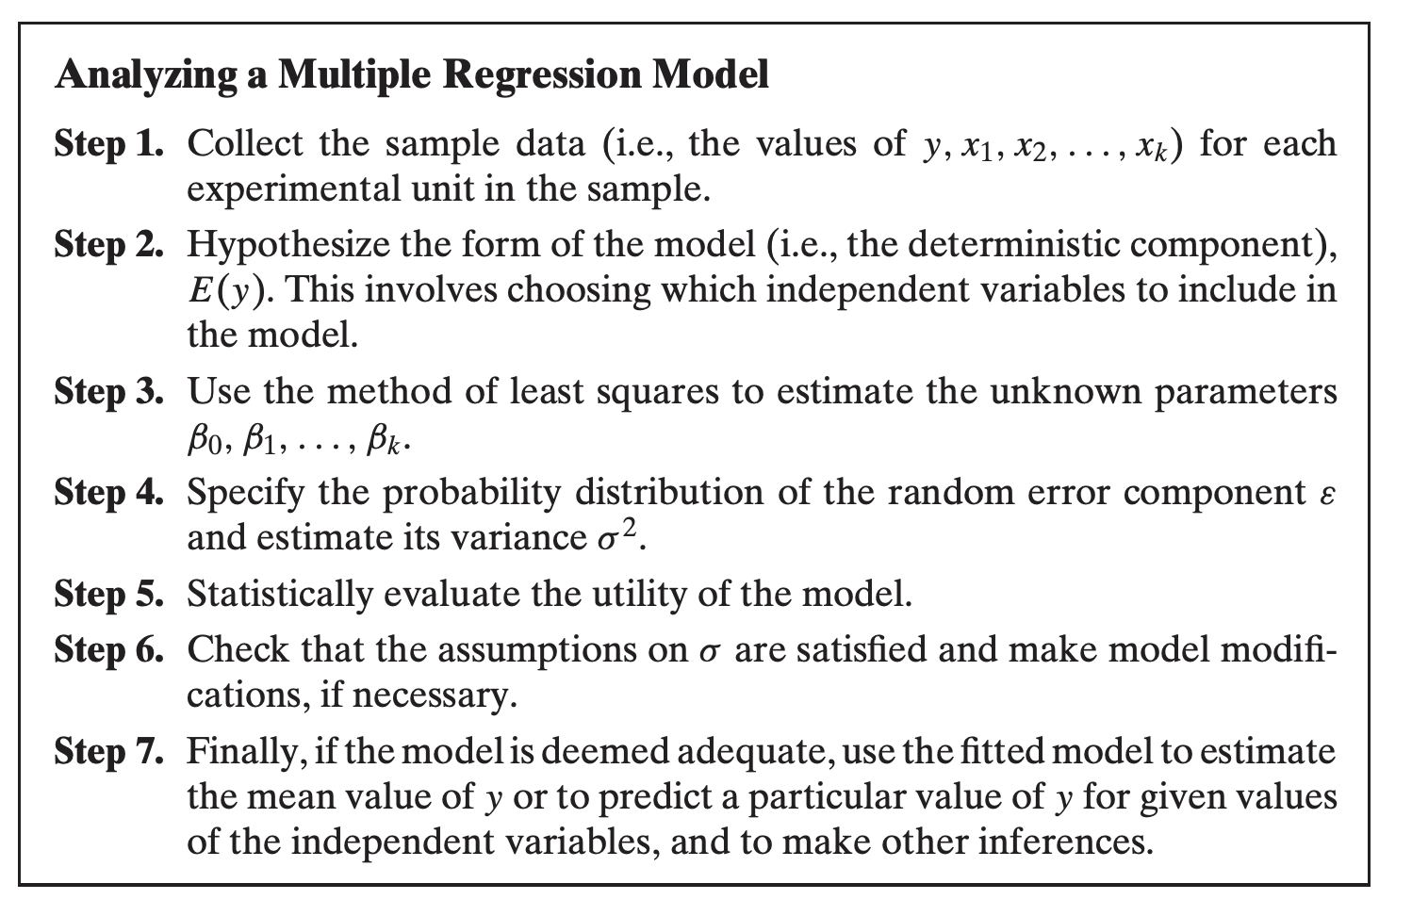
How to Fit a MLR

Slide 16
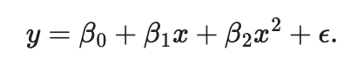
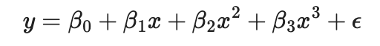
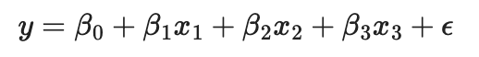
Order of Model
Highest Exponent of any Predictor Variable
A Model With no Higher-Order Terms is a First-Order Model
Higher-Order Terms
2nd order model
3rd order model
1st order model
$$y=β_{0}+β_{1}x_{1}+β_{2}x_{2}+β_{3}x_{1}x_{2}+β_{4}x_{1}^{2}+β_{5}x_{2}^{2}+ε$$

Slide 17

Practice

